Slide 1
PLCC ANNUAL STAKEHOLDER WORKSHOP
March 22nd, 2019
School of Architecture, Planning and Preservation
University of Maryland, College Park

Slide 2
Welcome back!
Gerrit Knaap, PLCC Co-Chair
Professor and Director, NCSG

Slide 3
Purpose of the Workshop
Bring the full range of PLCC stakeholders up to speed and get everyone organized for our future work

Slide 4
Agenda
Morning
Table Intros & Polling
Updates on Purple Line – MTA/PLTP
Discuss: Top opportunities & challenges
Organizing around our PLCC mission & vision
Key dimensions of PLCC’s work

Slide 5
Afternoon
Box Lunches
Speakers from both Counties
***Goal Area Table Discussions***
Key Insights
Next Steps
Reception – 3pm – please plan to stay

Slide 6
Follow us on Social Media
#PurpleLine
#PLCC
@PurpleLineCC

Slide 7
Table Introductions
At your tables, share:
Name
Organization
Why you are here, and why PLCC work is important to you

Slide 8
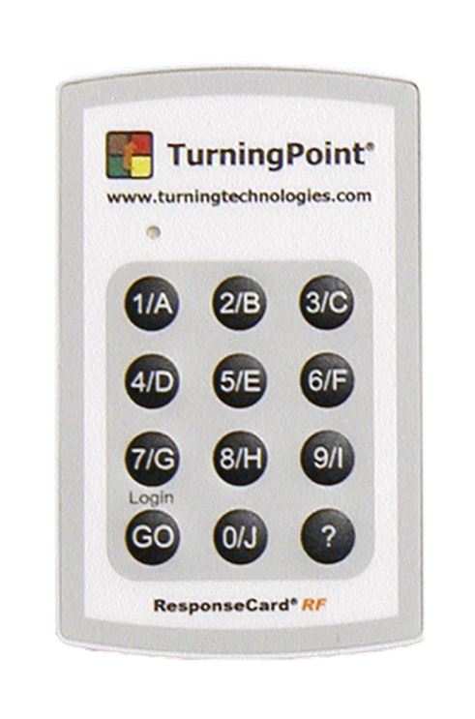
Keypad polling
Press the button of your choice
When you get the green light, your vote has been received
If you make a mistake, just vote again

Slide 9
Where do you live?
In Prince George’s and in the corridor
In Prince George’s but outside the corridor
In Montgomery and in the corridor
In Montgomery and outside the corridor
Somewhere else in the region
Outside the region but I love coalition meetings!
Notes:
My house

Slide 10
Right now I am…
Involved with work in the corridor
Not involved with work in the corridor but I have been
Not involved, but I plan to be in the near future!
… Purple Line, what’s the Purple Line corridor?

Slide 11
If you are involved in the Purple Line Corridor right now, are you involved with:
Housing
Small business and small business preservation
Workforce development
Neighborhood preservation
Transit oriented development along the line
Construction of the line
Keeping people informed about Purple Line issues
More than one of the above issues
An issue not in the above list
I am not involved at all currently

Slide 12
What do you see as the most important challenge along the corridor over the next few years?
Preserving the affordability of housing
Keeping residents and families from getting displaced
Helping business owners survive during construction?
Losing the unique character of current neighborhoods along the line
Supporting residents in getting good jobs during and after construction
Attracting new amenities that are currently lacking in parts of the corridor
Ensuring our neighborhoods become more walkable, bikeable and accessible
Some other option not listed here

Slide 13
What opportunity do you anticipate that the Purple Line will provide that you’re most excited about?
Moving more easily to jobs along the corridor
New vibrancy at many of the Purple Line stations
Great access to amenities for residents and workers in the corridor
The placemaking we can do at the station areas I most love
Creating jobs along the corridor
New or expanded opportunities for existing and new business owners
Access to educational opportunities
Some other option not listed here

Slide 14
Updates about the
Purple Line

Slide 15
Purple Line Update March 22, 2019
Purple Line Corridor Coalition
Stakeholder Workshop
Mike Madden
Deputy Project Director
Maryland Department of Transportation Maryland Transit Administration
Fred Craig
Chief Executive Officer, Purple Line Transit Partners

Slide 16
Purple Line: The Great Connector
Purple Line will connect:
4 segments of Metrorail
All 3 MARC commuter rail lines
21 stops
Amtrak Northeast Corridor
Interstate and local bus services

Slide 17
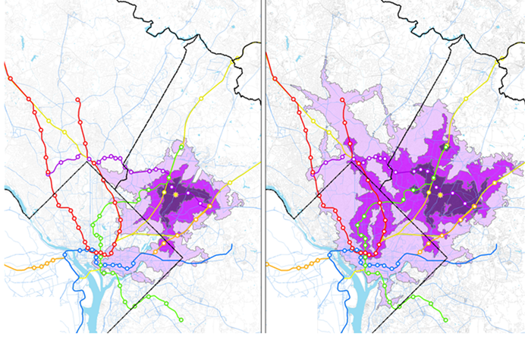
Expanding Access to Jobs
Without Purple Line
With Purple Line
Riverdale Park Station (commutes within)
 | 30 minutes
 | 45 minutes
 | 60 minutes
Source: UMD National Center for Smart Growth

Slide 18
Catalyst for Growth
More than $2 billion of real estate development is either underway or planned, four years before passenger service
Conservative estimate: 7.7 million square feet of development
Equals more than twice the usable square footage of the world’s largest office building, the Pentagon
The level of anticipated development underscores the need for this initiative to ensure development is done right
Source: BizNow, various articles in 2018

Slide 19
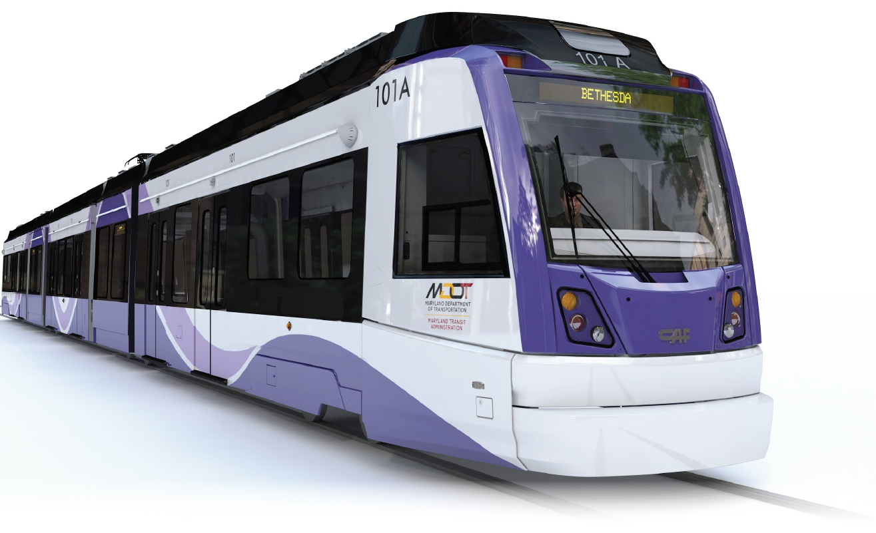
Project Overview
MDOT MTA’s goal for passenger service remains late 2022
Progress
Design: 85% complete
Construction: 10% complete
Vehicles: 10% complete
Construction underway throughout 16.2-mile corridor
Plymouth Tunnel and Glenridge Operations/Maintenance Facility (Prince George’s Co.) slightly ahead of schedule

Slide 20
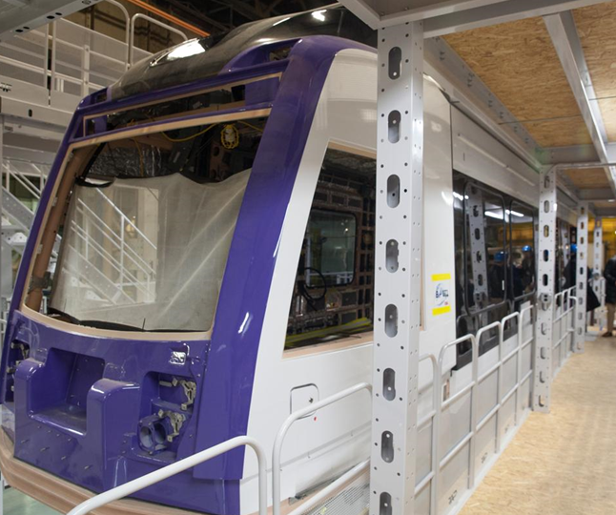
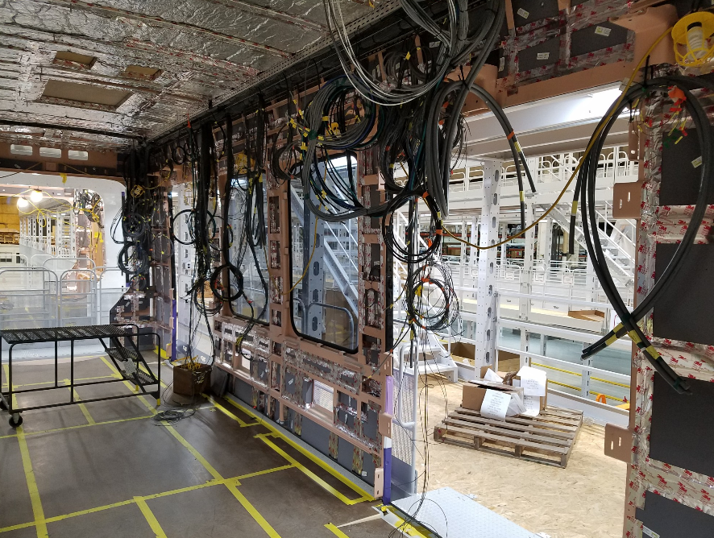
Vehicle Assembly
Vehicles being assembled in Elmira, NY
1st of 26 vehicles nearly complete
Local testing anticipated in 2021
431 passengers per car,
including 80 seats
Designated space for persons
disabilities & bikes
37 miles of wiring in each car =
College Park to Orioles Park

Slide 21
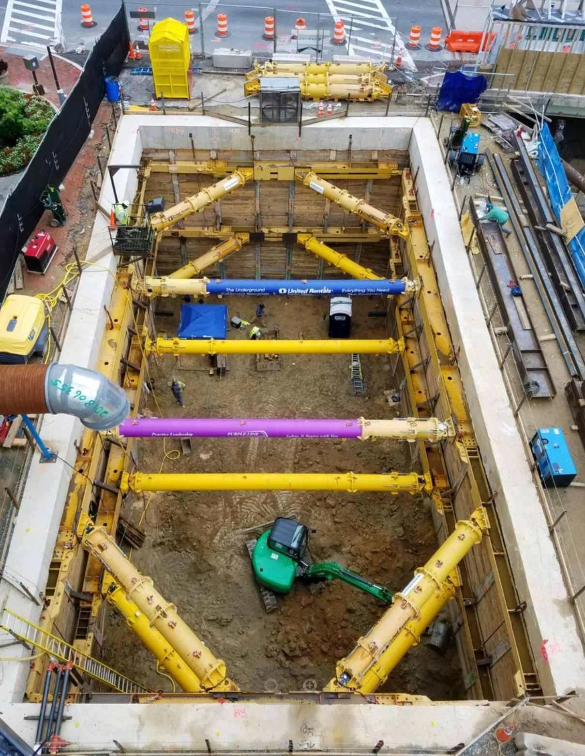
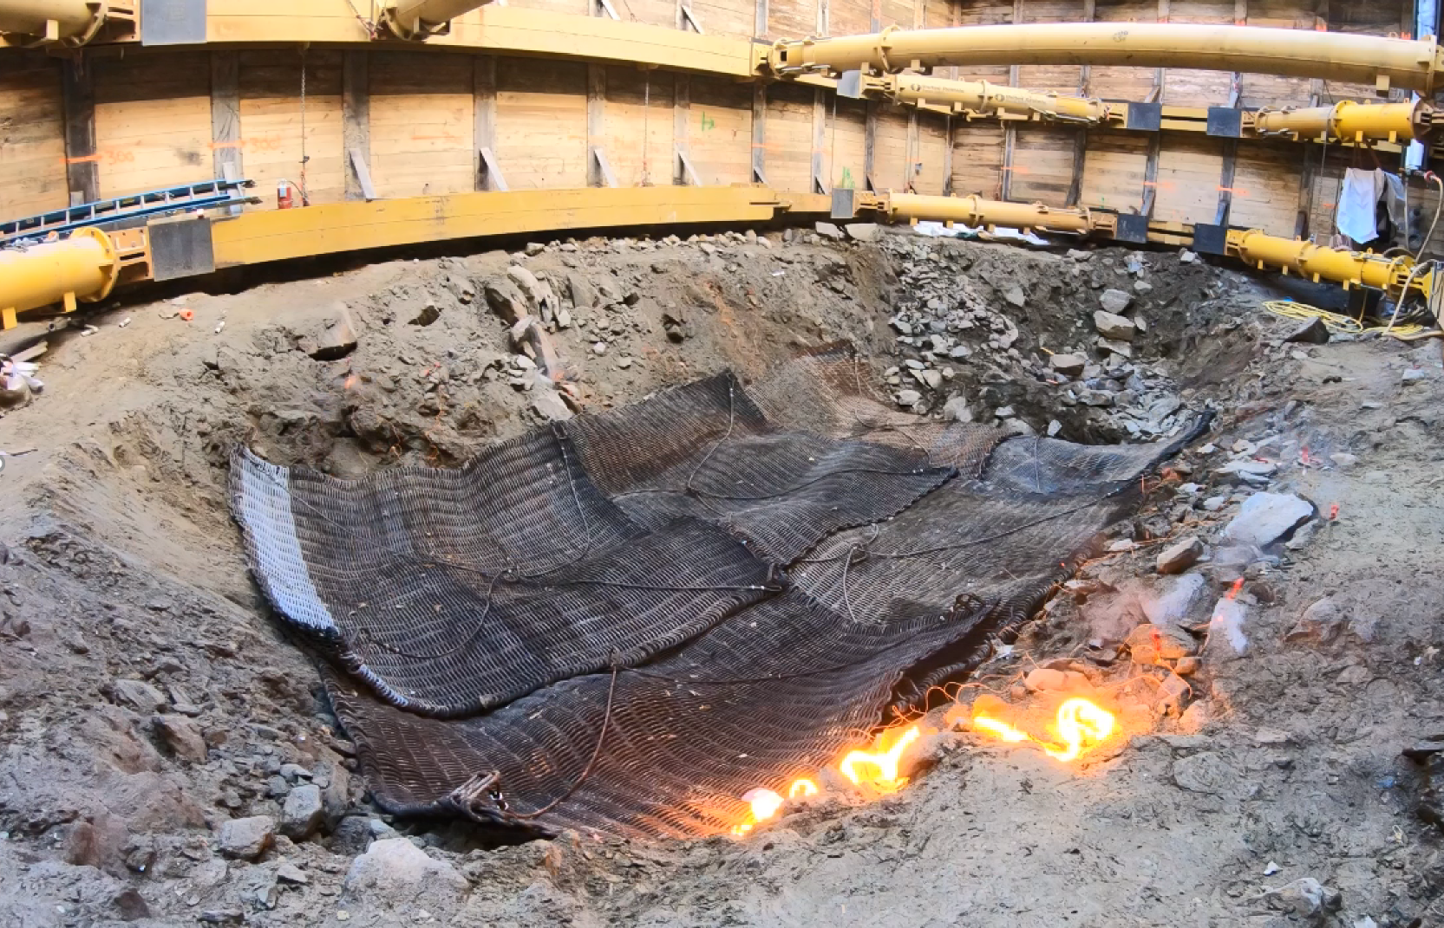
Bethesda Station Shaft
Elevator shaft currently halfway to Red Line depth (75 of 145 feet)
Weekday blasting to continue as needed

Slide 22
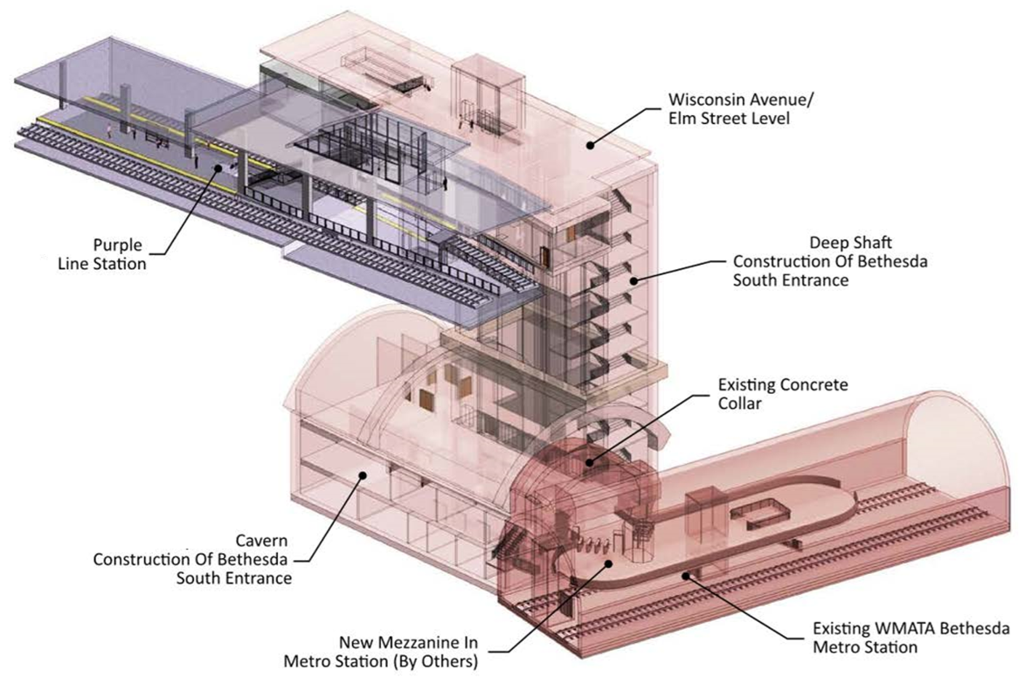
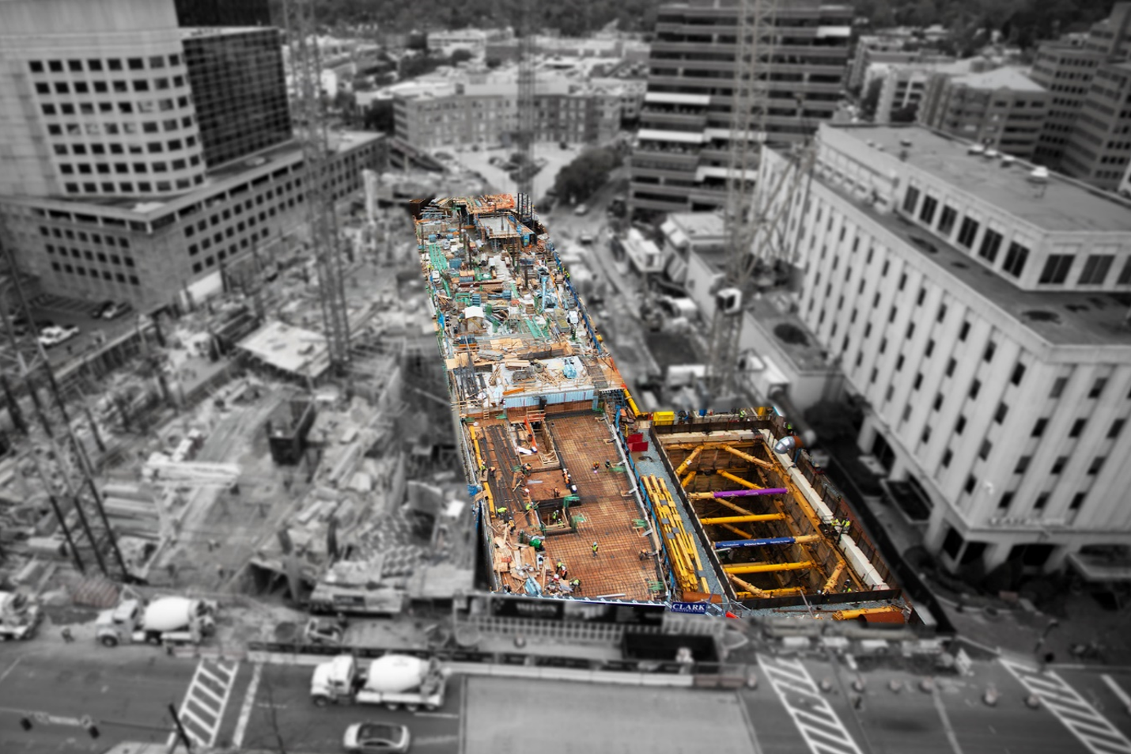
Bethesda Station Shaft
Per cooperative agreement with MDOT MTA, Carr Properties recently completed the shell of the Purple Line’s Bethesda Station
The station will be integrated into a high-rise office building

Slide 23
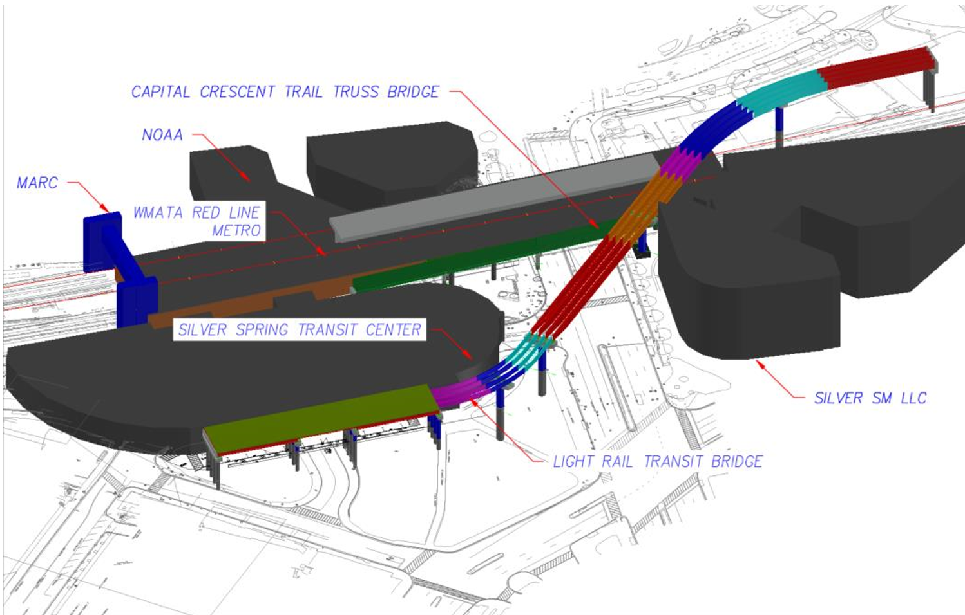
Silver Spring Transit Center
Goal: Simultaneously schedule major WMATA and Purple Line work
to minimize public disruption
Coordination with
WMATA and CSX
is key to construction
schedule

Slide 24
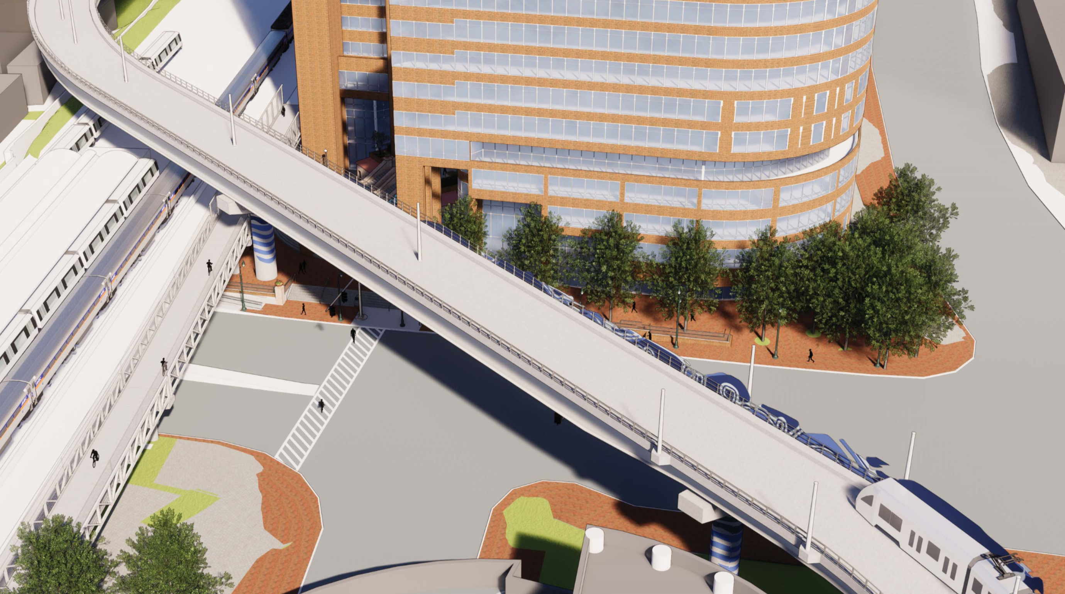
Silver Spring Transit Center
Work anticipated to start in spring 2019
Work zone and temporary pedestrian plan will be established prior to start. Pedestrian access will be maintained across Colesville Rd.
Initial work: Foundations for Purple Line track and Capital Crescent Trail bridges over Colesville Rd.
MTA and PLTC working with
County on outreach to local
businesses and SSTC users

Slide 25
Safety is Job #1
Through February 2019
More than 2.7 million safe work hours worked
Over 3,000 employees completed safety training

Slide 26
Traffic: What to Expect
Existing traffic patterns will change, both temporarily and permanently
Use caution and slow down when approaching work sites
Work may occur on both sides of the road and across roadways
When lane closures are required, notices are distributed via text and email (sign-up at purplelinemd.com)
Flag-persons will direct traffic, when required

Slide 27
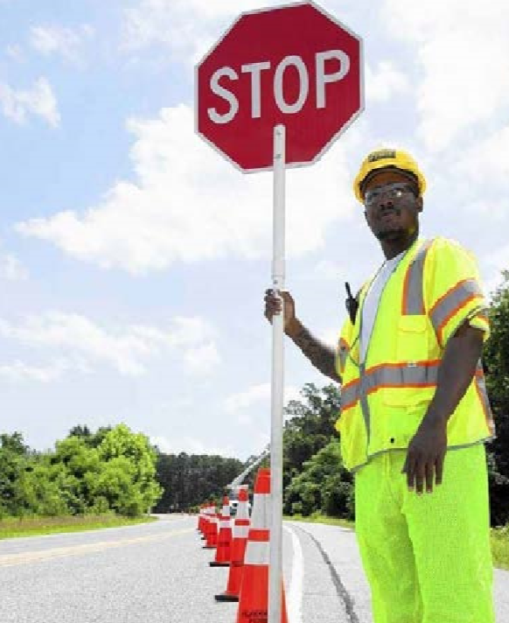
Pedestrians: What to Expect
Work zones will be clearly marked and pedestrians should not enter
Pedestrian detours will be clearly signed
When closures occur, alternate access will be provided
Pedestrian crossings will be maintained
Pedestrians should obey construction signage and keep out of work zones

Slide 28
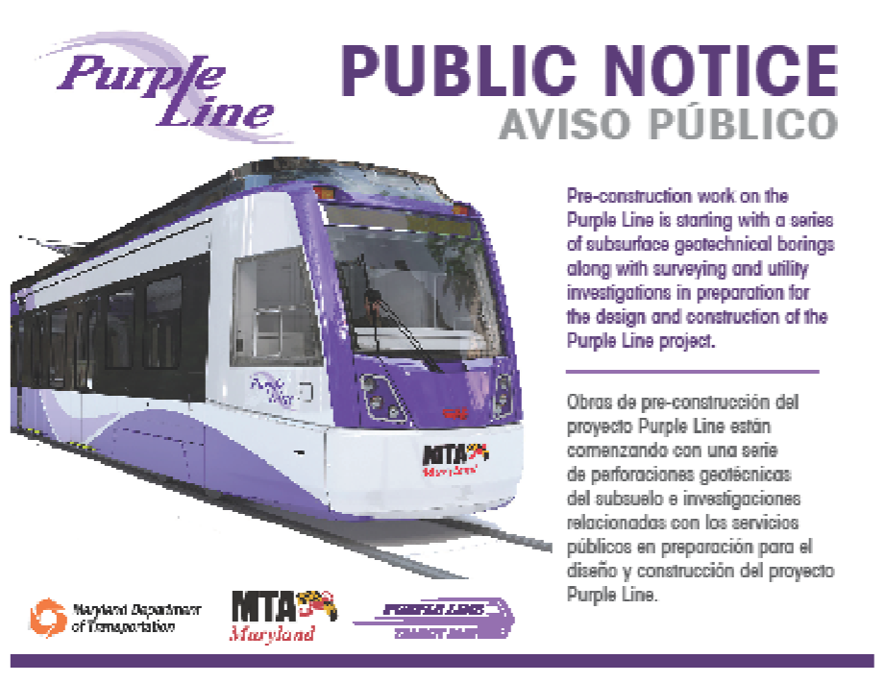
Impacted Business Outreach
Prior to construction, project team conducts one-on-one outreach with adjacent businesses to:
Understand access/delivery requirements, other special needs
Collaborate in identifying solutions
Coordinate with local businesses to design/install “open for business during construction” signs
Outreach conducted in English and Spanish

Slide 29
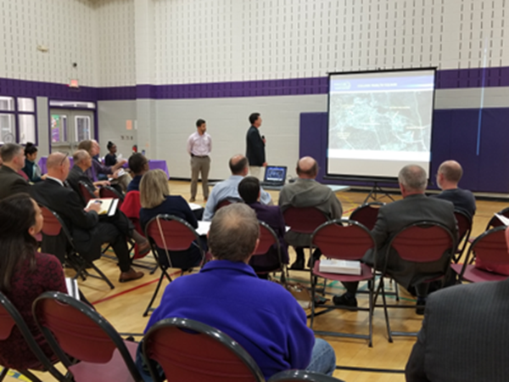
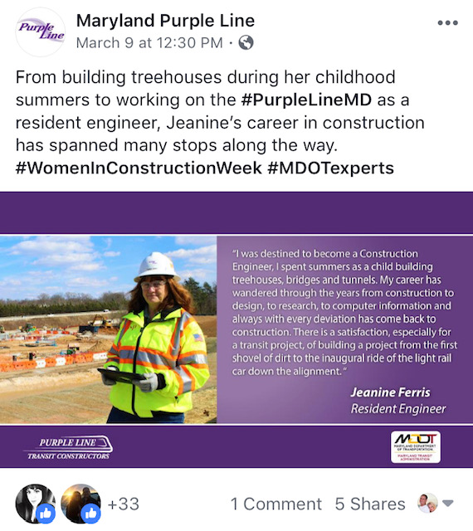
Public Outreach
Community Advisory Teams
4th round of CAT meetings start this spring
Other public meetings as needed
New Website
Planned launch this spring
Construction focused
Construction Updates
More than 5,000 resident & business recipients
Social Media
Active on Instagram, Facebook, Twitter
Media Relations
Highlight progress, facilitate accurate reporting

Slide 30
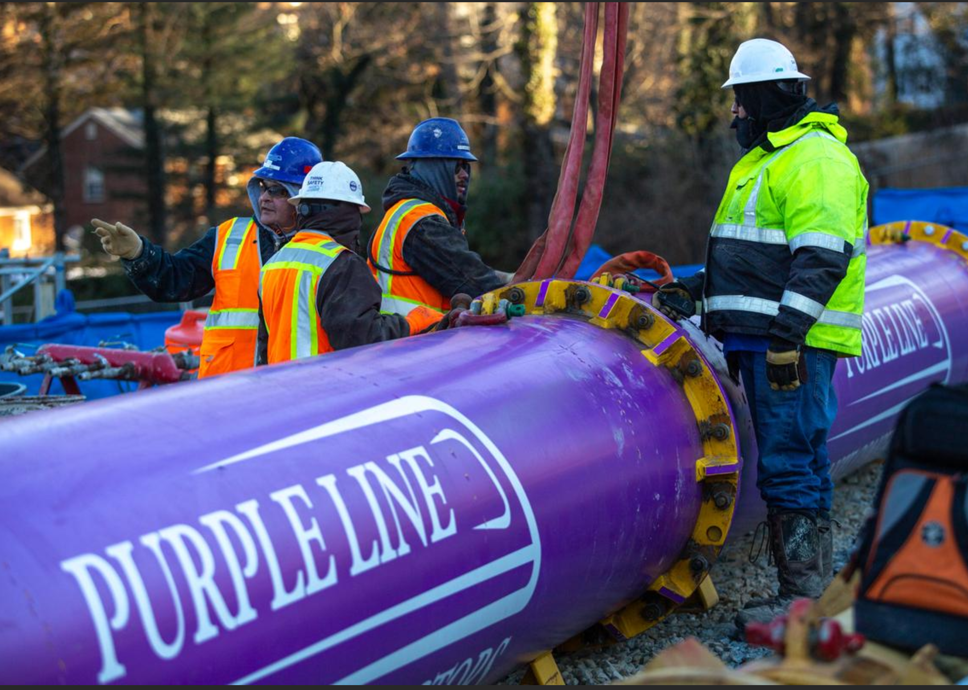
Expanding Economic Opportunities
Design DBE Goal: 26%
26.8% DBE participation to date
11 Prince George’s and
Montgomery county DBE firms
participating
Construction DBE Goal: 22%
6.2% DBE participation to date
26 Montgomery and Prince
George’s county firms
participating

Slide 31
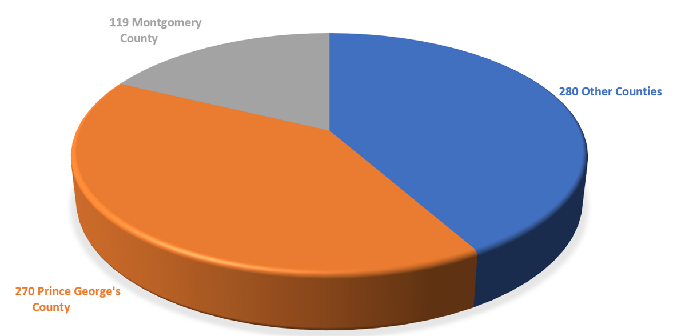
Local Job Creator
Project-wide Craft Employment by Jurisdiction
Prince George’s County | 270 | 25%
Montgomery County | 119 | 11%
Other Maryland Counties | 280 | 26%
Total Maryland Registration | 669 | 62%

Slide 32
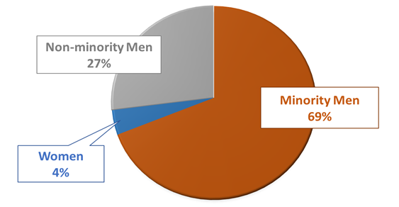
Affirmative Action/Equal Employment Opportunity
Category | Total | AA/EEO Goal | Current %
Full-time Employees | 466
Minority Participation | 321 | 28% | 68.9%
Female Participation | 19 | 6.9% | 4.1%
Non-minority Participation | 126 |  | 27.0%

Slide 33
Stay Up to Date on Purple Line Progress
Sign up for construction notices at Purplelinemd.com
For construction-related questions and concerns, contact PLTP:
Email at: outreach@pltcllc.com
24/7 hotline at 240-424-5325
For general project questions and comments, contact MTA public outreach:
Email at: outreach@purplelinemd.com
Call: 443-451-3706 or 443-451-3705 (Español)

Slide 34
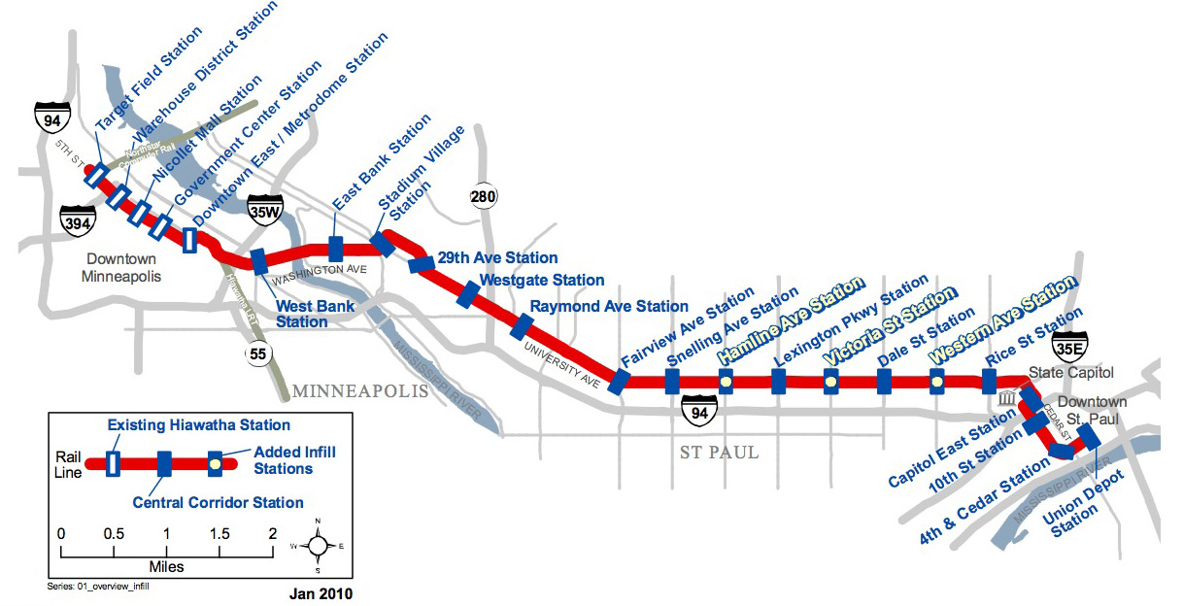
Inspiration from Minneapolis - St. Paul
Talking point from Steve
https://www.youtube.com/watch?v=GtolJfP_n4k

Slide 35
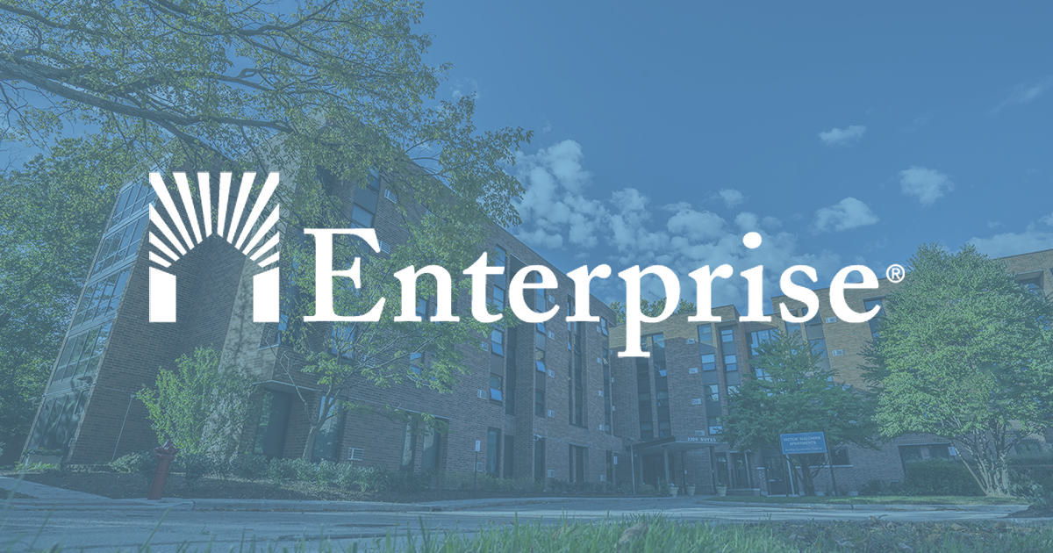
PLCC:
Organizing around our Mission & Vision
David Bowers, PLCC Co-Chair
Vice President, Enterprise Community Partners

Slide 36
What is the Purple Line Corridor Coalition?
The PLCC:
Engages, organizes and aligns many partners from diverse sectors in a shared vision to create and sustain this unique Purple Line transit corridor
Serves as a model for committed and equitable community development
Is committed to surmounting the economic, political, and community challenges along the way in order to create opportunities and capitalizing on the communities’ assets that will improve & invigorate livelihoods, neighborhoods, & local enterprise.

Slide 37
Our Vision and Our Opportunity
A once-in-a-lifetime chance to leverage Maryland’s largest transit investment in the 21st century.
A chance to increase access to:
Good jobs
Better housing choices
Vibrant communities
Ensure the Purple Line creates equitable, sustainable, & culturally appropriate development that enhances the livability of communities along the corridor.

Slide 38
Four Primary Goals
Business:
Diverse, locally established businesses prosper both during and after the construction period.
Workforce:
Workers in the corridor are well-trained, grow in number, and are well-matched with employers in skills and location.
Housing:
Housing opportunities are available for people of all incomes in communities throughout the corridor, especially current low- and middle-income, and transit-dependent residents.
Community:
Vibrant & sustainable communities enhance health, culture, & a sense of place.

Slide 39
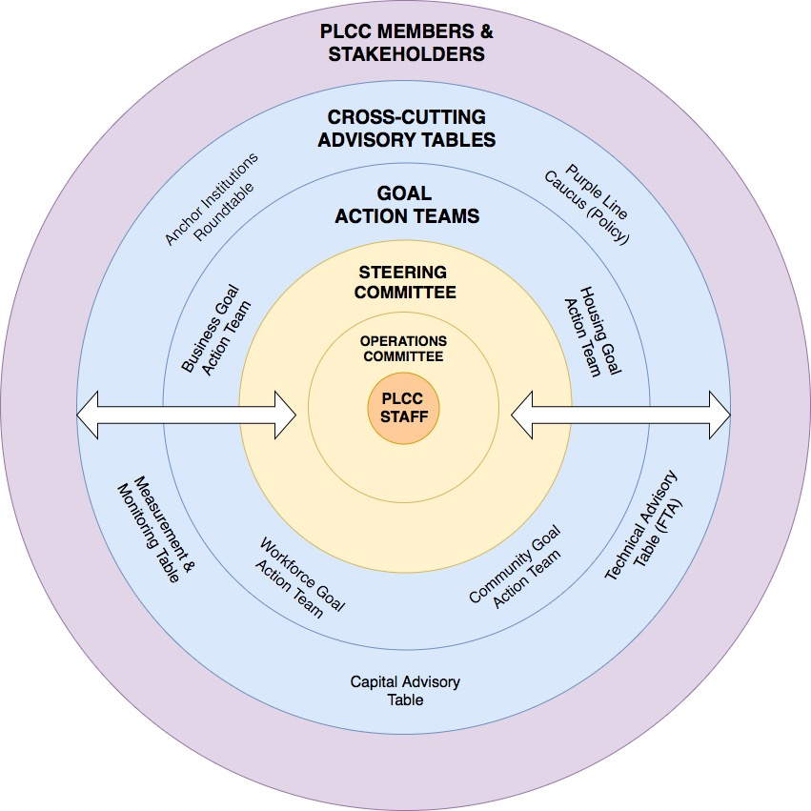
How We’re Organizing:
17-member steering committee
4 Goal Action Teams
5 Cross-cutting Advisory Groups
Large & growing community of stakeholders & supporters

Slide 40
Continuing PLCC steering committee members
National Center for Smart Growth
Enterprise Community Partners
CASA
Montgomery County
Prince George’s County
MNCPPC Montgomery
MNCPPC Prince George’s
Purple Line Now

Slide 41
New Members of PLCC Steering Committee
Housing Initiatives Partnership
Latin American Economic Development Corporation
Montgomery Housing Partnership
Kaiser Permanente

Slide 42
Celeste James, Executive Director of Community Health

Slide 43
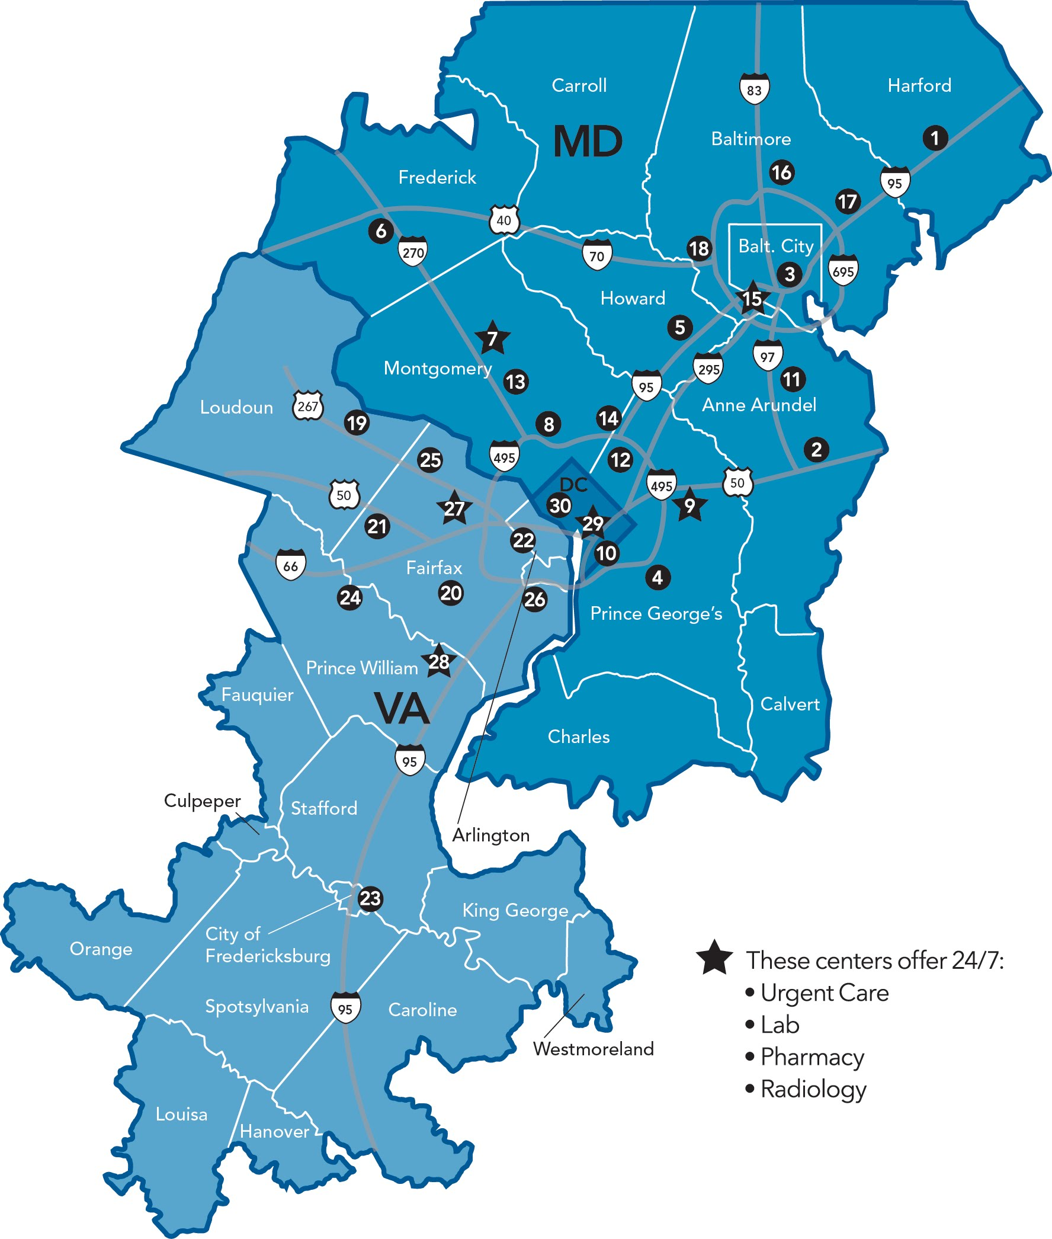
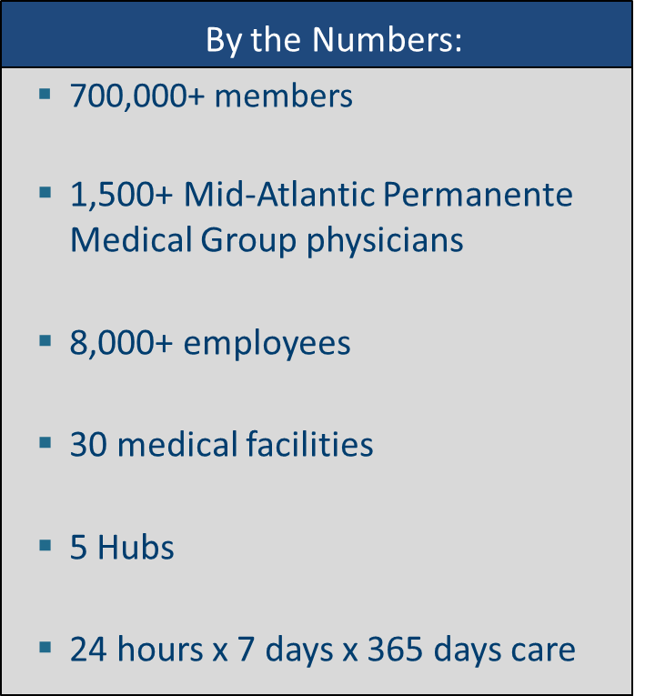
Kaiser Permanente in the Mid-Atlantic States: By the Numbers
43
Notes:
We are committed to expanding access to our high-quality, convenient care throughout the Mid-Atlantic.
MAS fast facts:
More than 720,000 members
More than 1,500 Mid-Atlantic Permanente Medical Group physicians
More than 8,000 employees
30 medical facilities (five expanded Medical Centers)
24 hours / 7 days / 365 days care available

Slide 44
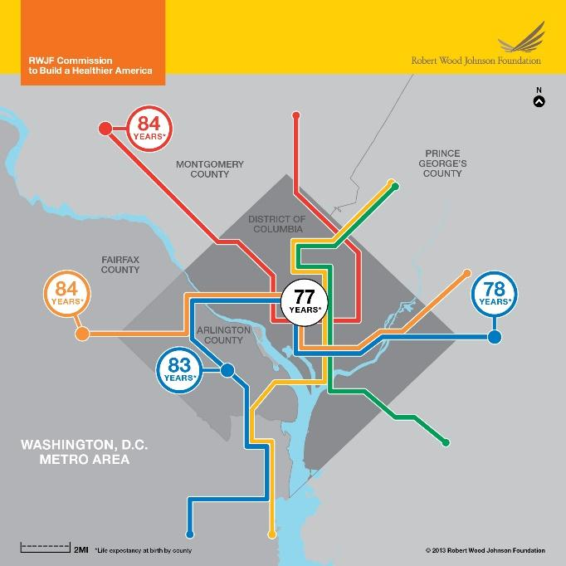
WHAT IS MAKING US SICK?
Your zip code is a better predictor of health than your genetic code.
Only 20% of a person’s health is determined by the moments they spend in a healthcare environment, 30% by health behaviors, and the remaining 50% by socioeconomic factors and physical environment.
Addressing issues upstream (such as economic stability, education and housing) is critical to improving health and fostering equity.

Slide 45
Deepening our Engagement
Purple Line Corridor Coalition Steering Committee Member
Accelerating Investments for Healthy Communities (AIHC) - Kaiser Permanente selected the Purple Line as its focus to participate as one of 6 health systems in this nationwide program of the Center for Community Investment designed to help health institutions and their community partners to deploy their assets to advance affordable housing as a way to create more equitable, sustainable and healthy communities. - Kaiser Permanente’s collaborative team for the program includes key community and PLCC stakeholders

Slide 46
Deepening our Engagement (cont’d)
Planning grant to PLCC member Central Kenilworth Avenue Revitalization CDC
Lead community engagement and visioning in the Greater Riverdale area, crossed by 3 of the Purple Line stops, around objectives that KP shares with the coalition: Thriving Communities, Economic Development, and Affordable Housing.
Understand what success would look like from a community perspective
Establish baselines and collaboratively design solutions to improve outcomes

Slide 47
Table Discussion
At each table, identify:
No more than two challenges that the corridor (& coalition) must deal with as construction is now well underway.
No more than two opportunities that the coalition and/or others in the corridor should actively pursue - now that the construction is well underway.

Slide 48
PLCC:
Key Dimensions of our Work

Slide 49
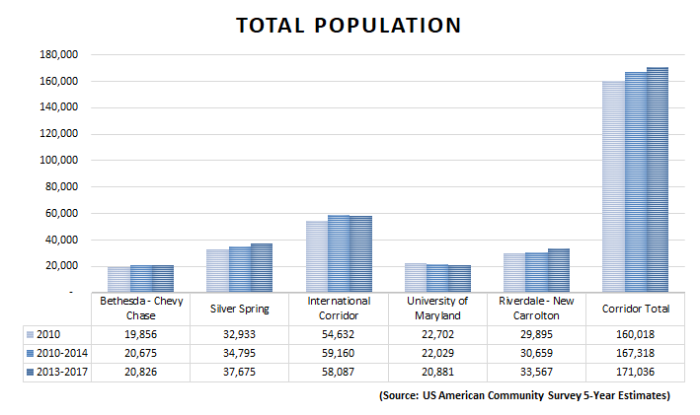
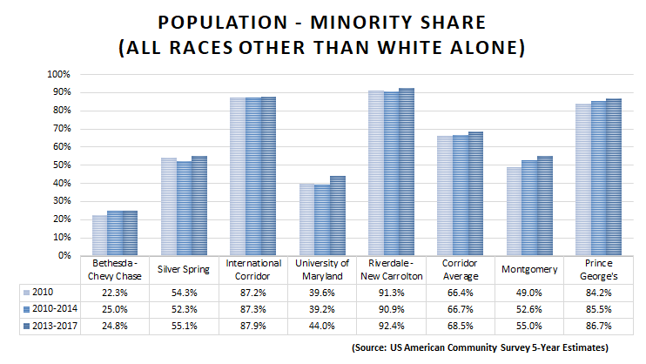
PLCC Data - Demographics
Steady population growth
Now over 170,000 people within about a half mile of the corridor
Increasing corridor diversity in all areas - now over 2 out of 3 residents are nonwhite

Slide 50
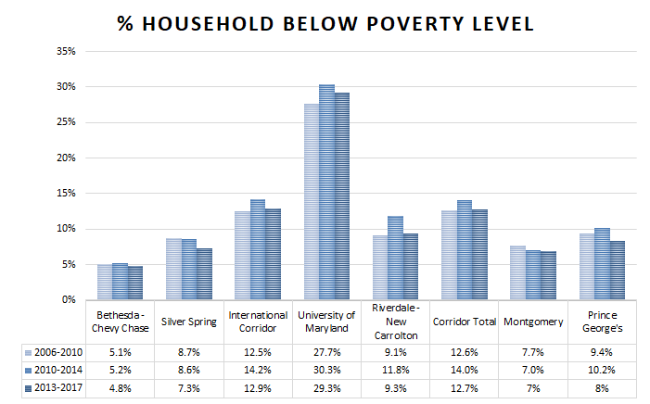
PLCC Data - Poverty
Continued east-west divide
Small decreases in poverty rate over the last decade, but overall, high compared to the region
Poverty still near or over 10% in the international corridor and Riverdale-New Carrollton
STUDENTS

Slide 51
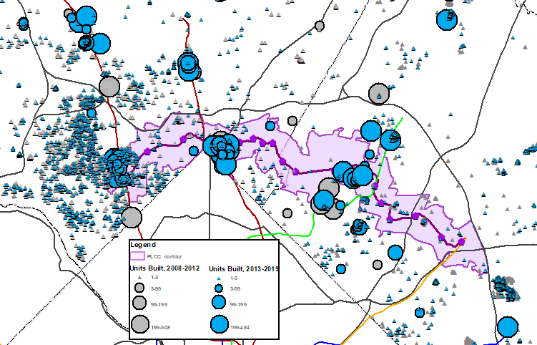
PLCC Data - Housing Construction
5,542 units built inside the corridor in Montgomery from 2008-2017
1,119 units built inside the corridor in Prince George’s from 2008-2018
These numbers are estimates from tax assessment data.

Slide 52
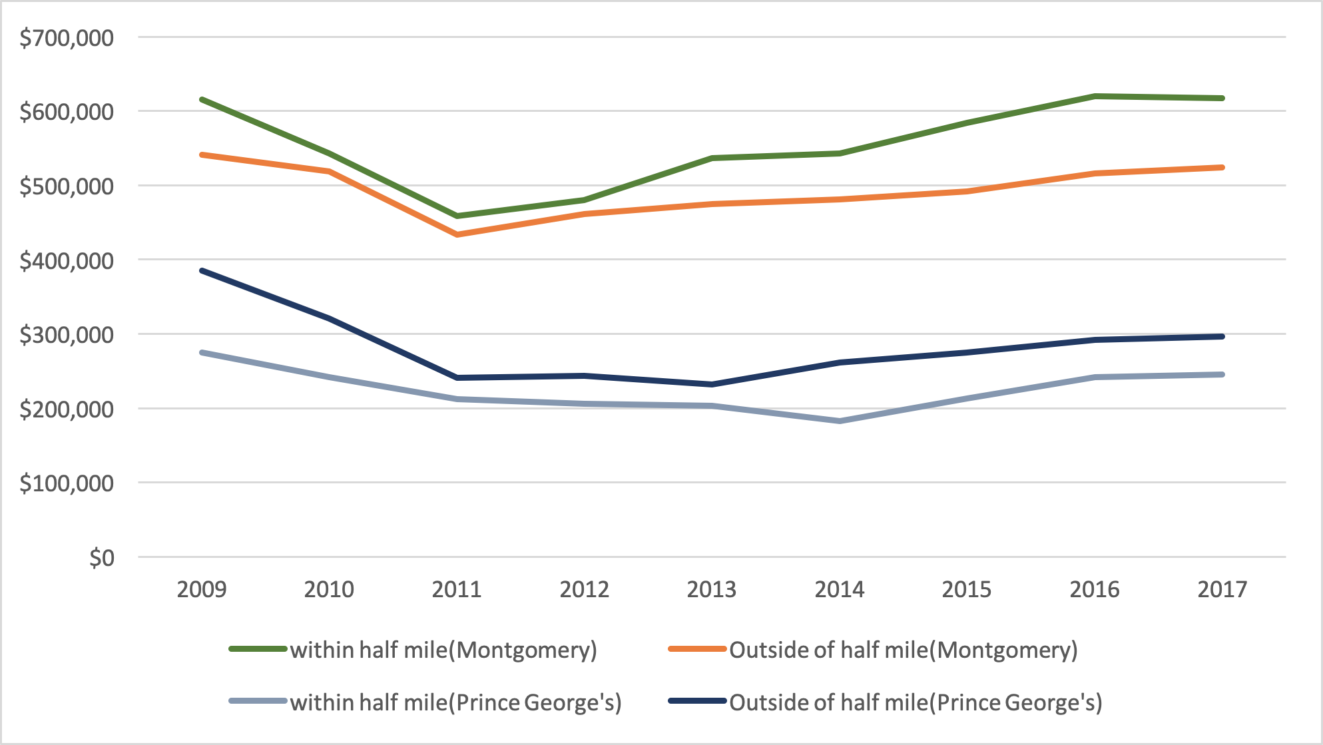
PLCC Data - Single Family Home Prices
Home prices within one half mile of the Purple Line are increasing in both counties
Homes within one half mile in Montgomery come at a significant (and increasing) premium
Prices in Prince George’s are still lower in the corridor
Average Single Family Home Sale Price

Slide 53
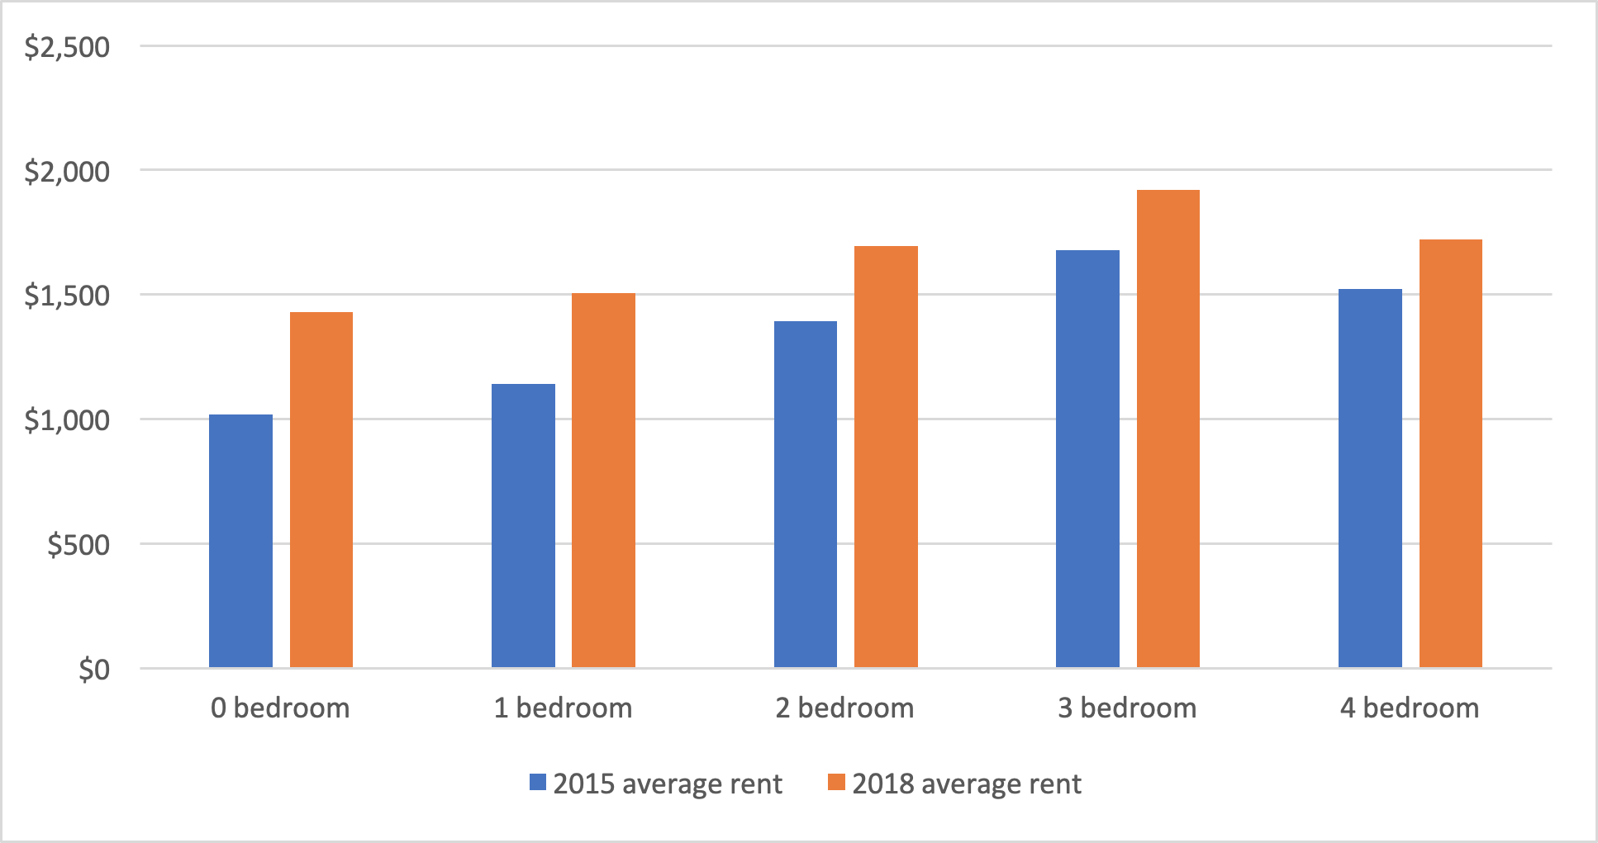
PLCC Data - Multi-Family Rents in Montgomery
Rent Price within ½ mile of Purple Line Stations - Montgomery County
Data source: Montgomery Rental Housing Surveys
Steady rent increases from 2015 to 2018

Slide 54
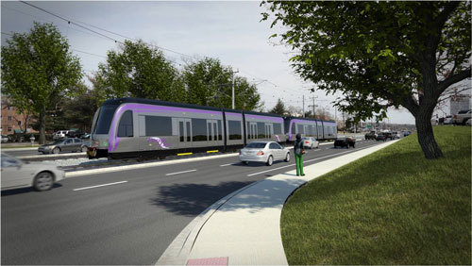
Survey: CDA Implementation Progress
Over the past 6 months, we have asked PLCC members how they have been implementing the CDA through their work
We’ve received detailed responses from 11 organizations
Here’s what we heard...

Slide 55
High level results from PLCC Survey - Business
Respondents who identify as working toward business goal:
CASA
CHEER
CKAR CDC
LEDC
Maryland SBDC
Montgomery County Executive’s Office
Montgomery Housing Partners
Northern Gateway CDC
Montgomery County DHCA
Montgomery County Planning
Prince George’s County EDC
Outreach to small businesses re. available resources
Baseline business assessments
Open houses and office hours with business owners
Business counseling and new businesses formation
On site and off-site technical assistance (bilingual)
Business-focused grants
Small business loans
Business association support and activities
Marketing to promote business areas
Improving street scaping and façades
Small business mapping
Sector/street design guidelines
Many respondents need more funding and dedicated staff/counselors to provide support at the scale needed.

Slide 56
High level results from PLCC Survey - Housing
Respondents who identify as working toward housing goal:
Enterprise
CASA
CHEER
Housing Initiative Partnership, Inc.
Montgomery County DHCA
Montgomery County Planning
Montgomery Housing Partners
PLCC Housing Workgroup
Developing a capital absorption framework
Creating Pipeline and Enabling Environments groups
Housing Action Plan
Working to increase local housing trust funding
Multifamily housing rehabilitation, preservation
Mixed-income development
Homeowner Rehab Assistance program and housing counseling services
Tenant information and support
Accelerated Investments in Healthy Communities
Respondents want more tools from local government that support rights of tenants and homeowners.

Slide 57
High level results from PLCC Survey - Workforce
Respondents who identify as working toward labor goal:
Montgomery County Planning
Housing Initiative Partnership, Inc.
Purple LIne Transit Partners
CKAR CDC
Job readiness training
Construction labor and workforce development plan
Respondents feel that much of their work in business development also positively impacts labor development in the corridor.

Slide 58
High level results from PLCC Survey - Community
Respondents who identify as working toward vibrant community goal:
CASA
CHEER
CKAR
Enterprise Community Partners
Housing Initiative Partnership
Maryland Milestones/ATHA, Inc.
Northern Gateway CDC
Montgomery County DHCA
Montgomery County Planning
Montgomery County Executive Office
Montgomery Housing Partnership
Bicycle-pedestrian priority area programming near stations
Bicycle master plan (Montgomery County-wide)
Trails and pedestrian pathways are being restored in anticipation of connecting with PL and PL trails
Signage and effective/inclusive way-finding
Community events
Artistic monument maps
Community story maps
Safe Community Initiatives
Respondents feel that much of their work in business development and housing also positively impacts vibrant communities in the corridor. Respondents feel they need to better connect with others in the corridor working on similar and parallel projects.

Slide 59
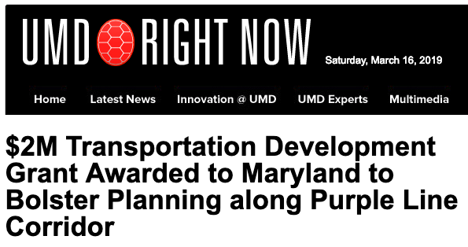
FTA TOD Planning Grant
$2 Million from FTA to MTA
Grant supports CDA implementation
Four main work areas
PLCC support
Multi-mobility plan and web tools
Corridor-wide economic development plan
Small business needs assessment and support strategy
TOD Finance plan
Two-year work plan

Slide 60
Lunch Break
Please grab your boxed lunch and
return to your table

Slide 61
County Executive Marc Elrich

Slide 62
Floyd Holt, Deputy Chief Administrative Officer Prince George’s County

Slide 63
Opportunities
Workforce
Purple Line will increase access to living wage jobs
Education and training are critical
Small business
Position businesses for post construction success; leadership on engagement; commercial tenant protection
Housing
Public land; inclusionary zoning; aging in place; opportunity zones; equity and grants
Community
Access to stations; signage; wayfinding; walkable communities; density

Slide 64
Challenges
Workforce
Identifying qualified workers, hiring local workers
Small Business
Preservation; access; parking
Housing
Affordability; preservation; balance of growth and preservation; rising prices;
Community
Disruption; health impacts; newcomers and long time resident conflict; maintaining diversity

Slide 65
Good Takeaways
How do we keep the lines of communication open, in terms of work that stakeholder organizations are already doing?
Disconnect between high level conversations (like those in this room) and local knowledge about the Purple Line
Purple Line is a path to living wage careers
Positioning businesses for post construction success

Slide 66
Test of Your Knowledge of the Purple Line

Slide 67
Please select a Team!
Team 1 – Left Side
Team 2 – Right Side

Slide 68
How many residents live along the Purple Line Corridor?
107,000
134,000
159,000
176,000

Slide 69
In 2000, Hispanics made up about 24% of the population in the corridor. What is the percentage of Hispanics in the corridor as of 2015?
27%
31%
34%
38%

Slide 70
Who is the largest employer in the corridor?
Starbucks
WMATA
National Oceanic and Atmospheric Administration
M-NCPPC
IRS
University of Maryland, College Park
University of Maryland University College
National Institutes of Health
Maryland CVS Pharmacy, LLC

Slide 71
Which subarea of the corridor has the largest number of small businesses jobs? (50 or fewer employees)
Bethesda-Chevy Chase
Silver Spring
International Corridor
University of Maryland
New Carrollton

Slide 72
Renter-occupied units account for more than 53% of all housing units in the corridor. Which sub-area has the highest percentage of renter-occupied housing units?
Bethesda-Chevy Chase
Silver Spring
International Corridor
University of Maryland
New Carrollton

Slide 73
And the winner is…..
181.71 | Team 2 – Right Side
179.13 | Team 1 – Left Side

Slide 74
Breakout Group Instructions
Discussions – led by table facilitators
Briefly review the handout for your Goal area
Discuss:
What else is happening and/or what else is planned for this Goal area going forward that is not listed?
What should the priorities in this Goal area be for the next 12 months?
Who should be involved in planning & implementation for this Goal area?
How do you want to be involved?
Help your facilitator capture the key points throughout the discussion

Slide 75
Sharing Insights from the Breakout Discussions

Slide 76
Final Task - Tomorrow’s Headline?
Agree as a table on a 1-sentence news headline about what we as a coalition will have accomplished 3 years from now!

Slide 77
Final Task - Tomorrow’s Headline?
Report Out

Slide 78
Next Steps
Continue to develop and staff the PLCC
Launch work on the FTA grant
Identify leadership, form and convene the Workforce Development work group
Form and convene the Vibrant Communities workgroup
Reconvene the Small Business/Economic Development work group
Complete and begin to implement the Housing Action Plan
Form and convene the Purple Line Caucus
Form and launch Anchor Institutions roundtable
Continue Measurement and Monitoring
Develop and launch Communications strategy.

Slide 79
Next steps
If you haven’t, please sign the Community Development Agreement!
http://purplelinecorridor.org/agreement/

Slide 80
Adjourn to Reception
Please join us for
a Beer, Wine & Cheese Reception from 3-5p
Thank you for coming!
Notes:
We invite you to join us now for wine, beer and refreshments on the far end of the first floor hall in front of the Gallery.

